Slide 1



Mobile and Social Computing
Project Work
Arash Sattari
arash.sattari@gmail.com
Haejong Dong
s2haejong@gmail.com

Slide 2
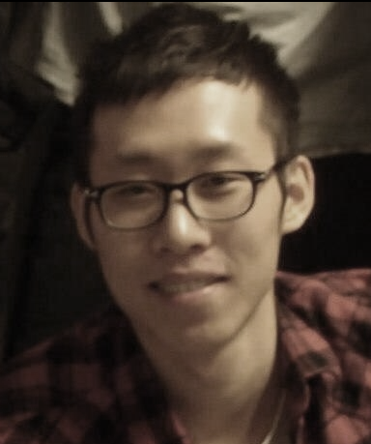
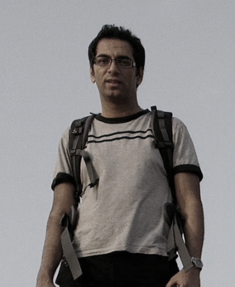
Who is the team?
Haejong Dong
Arash Sattari

Slide 3
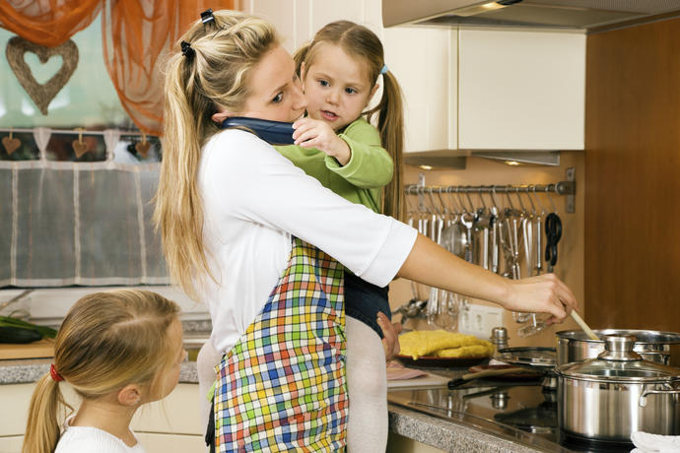

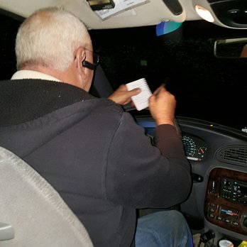
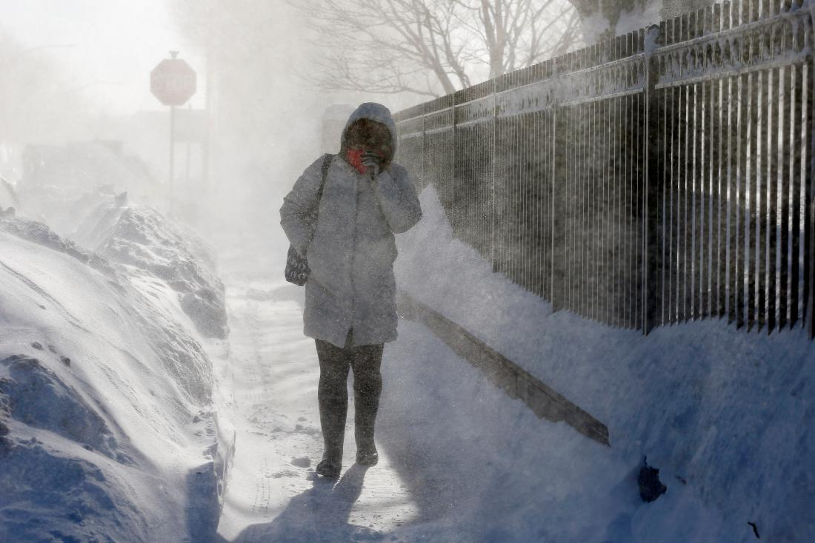
How do we support family ?
3

Slide 4
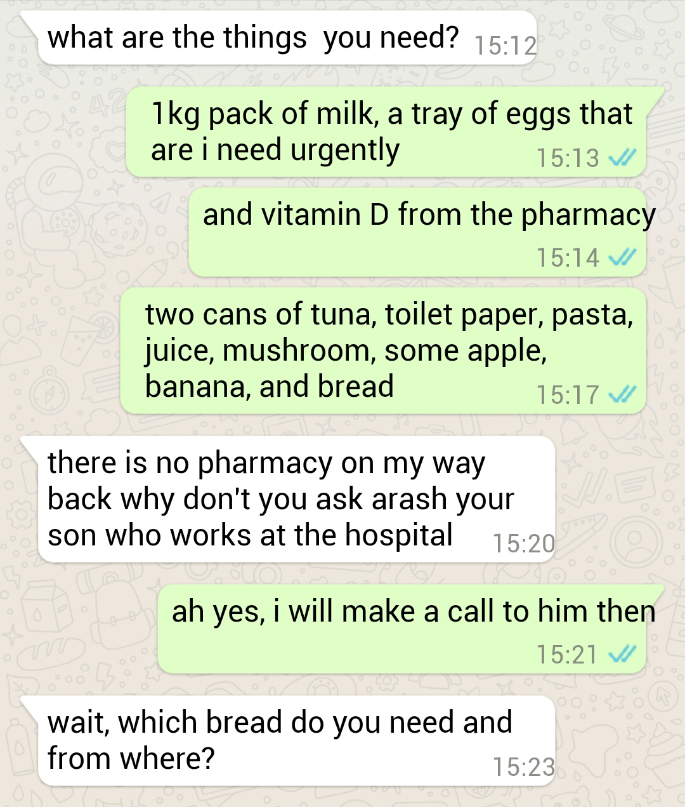
How do we support family ?
4
Notes:
How is our system different from messenger app and what’s advantages?
Can avoid mixing up list of items with other general conversation
Can manage the job by a single app which otherwise it may turn out to require a series of calling and texting to the different family members
Allow the family to work time efficient

Slide 5

Video demo
5

Slide 6
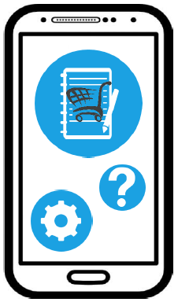
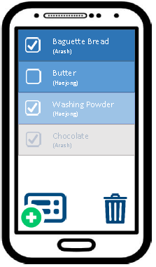
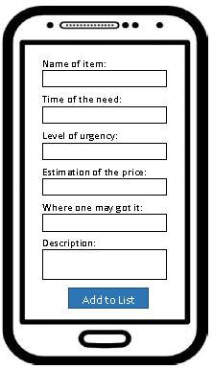
Paper-prototype v1
6

Slide 7
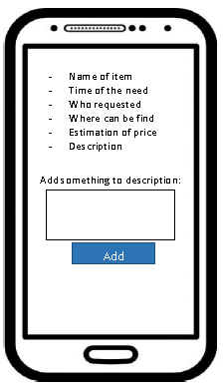
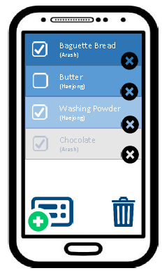
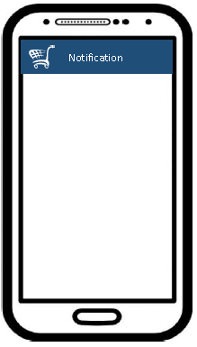
Paper-prototype v1
7

Slide 8
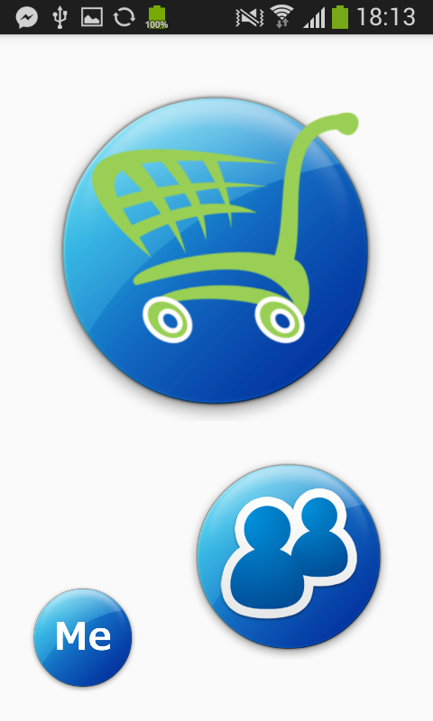
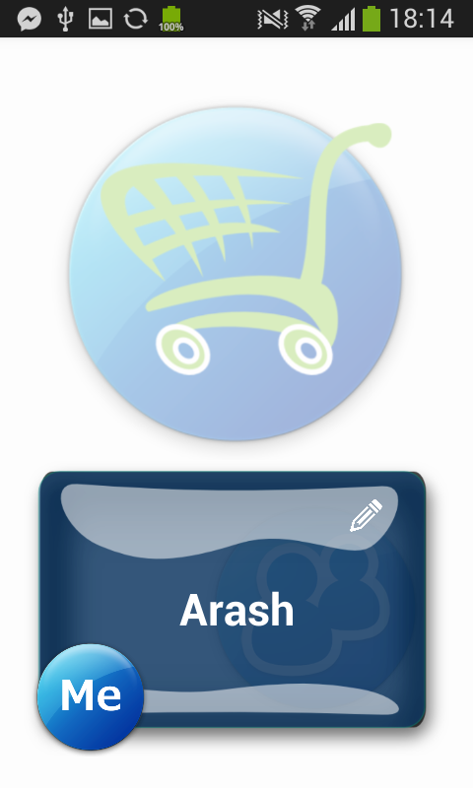
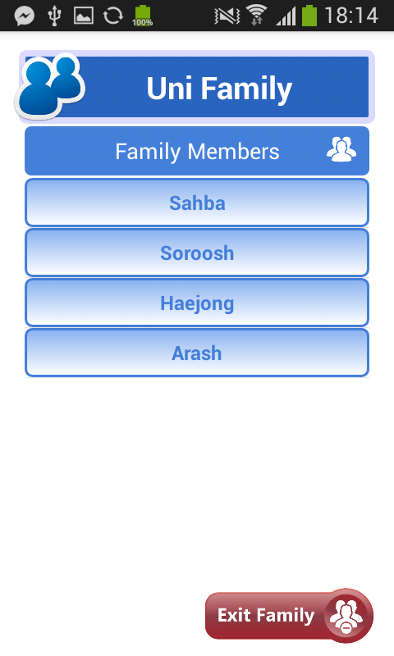
Changes & Improvements
UI/UX design
8

Slide 9
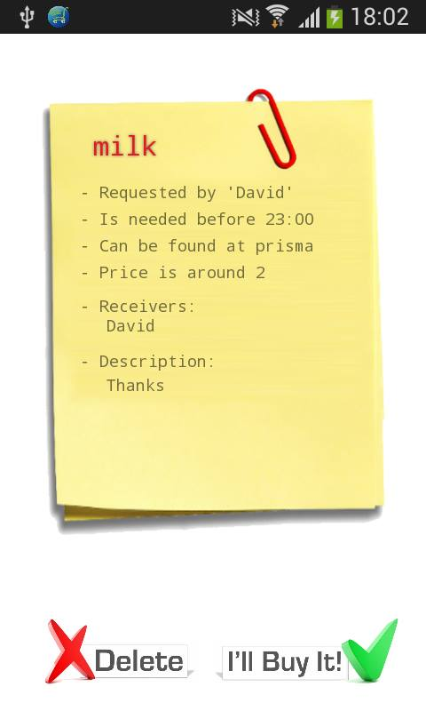
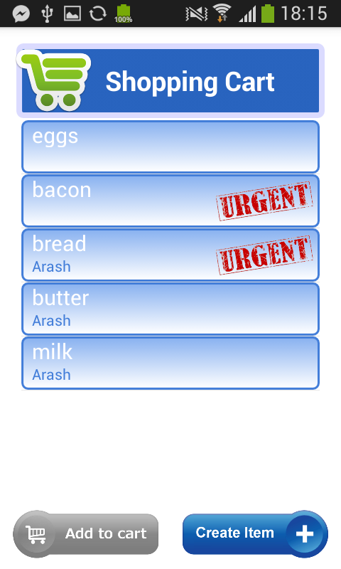
Changes & Improvements
UI/UX design
Color and icon based UI → text based UI
9

Slide 10
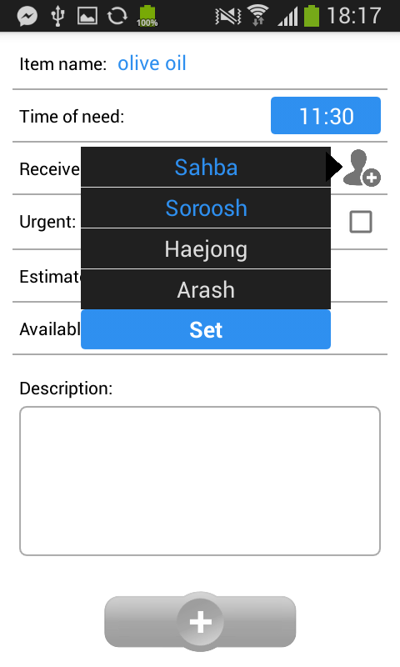
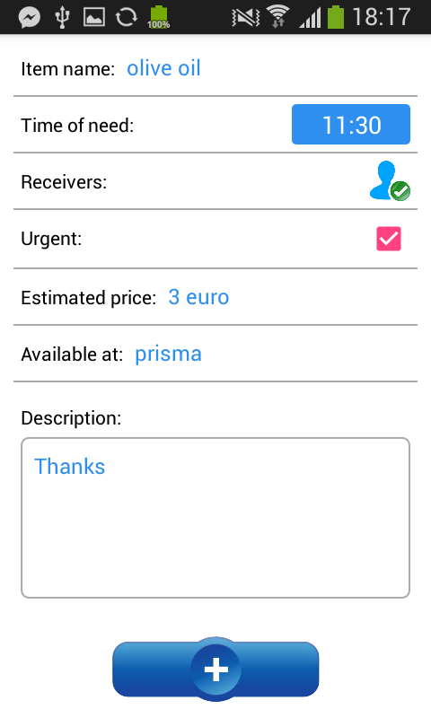
Changes & Improvements
UI/UX design
10

Slide 11
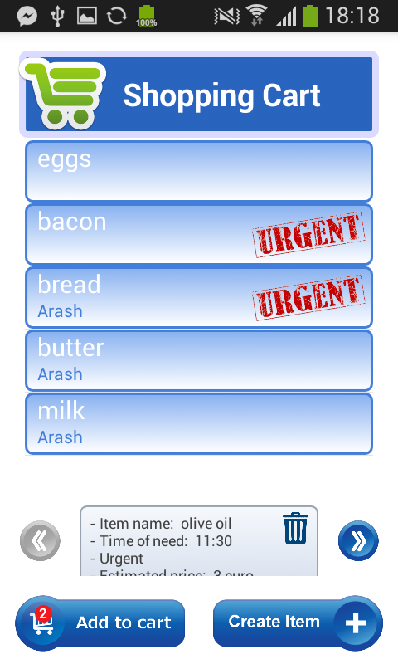
Changes & Improvements
UI/UX design
11

Slide 12
Changes & Improvements
Features
Registering multiple requests at once
Security
Stored encrypted
HTTPS
Unhackable URLs
Performance
ID management
Server queries weather information based on GPS data which client provide when it registers a new request
Possible extension to the research which will relates items people request to the regional weather condition and seasons
12

Slide 13
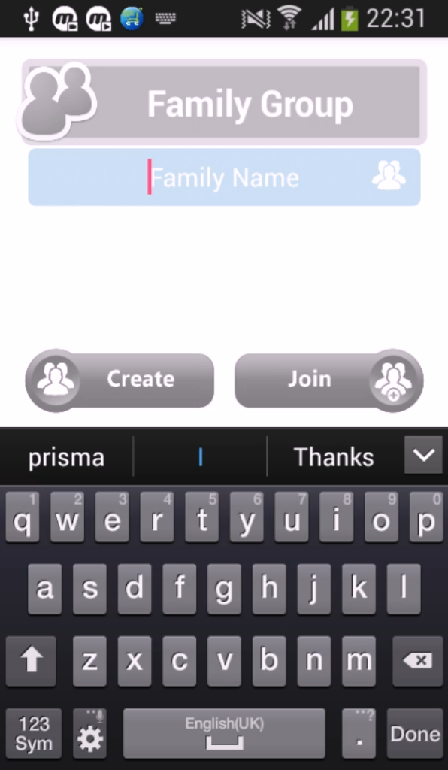
Application alpha_v1
13

Slide 14
Application alpha_v1
14

Slide 15


15

